Slide 1
RaspiGuard
By Vivek Socrates, Karel Tutsu, & Heakeme Williams

Slide 2

Purpose
Low cost monitoring system
Easy to use and setup
Monitor light, door and moisture of plants
Access data from phone, website, and hardware

Slide 3
Budget
Component |  | Cost
Raspberry Pi Model B |  | $39.95
adafruit PiTFT Plus 480x320 3.5" |  | $44.95
Raspberry Pi Power Adapter |  | $16.95
adafruit ADS1115 |  | $14.95
ADATA Premier 8GB microSDHC UHS-I Class 10 |  | $8.99
ADATA microReader Ver.3 microSDHC |  | $4.99
SparkFun Soil Moisture Sensor |  | $5.95
Photo Cell (CdS Photoresistor) |  | $0.95
Magnetic Contact Switchs |  | $3.95
Raspbian (OS) |  | $0.00
2x13 Female Header |  | $0.95
10K Resistor |  | $0.25
SUBTOTAL | $142.83
TAX | $18.57
TOTAL | $161.40

Slide 4
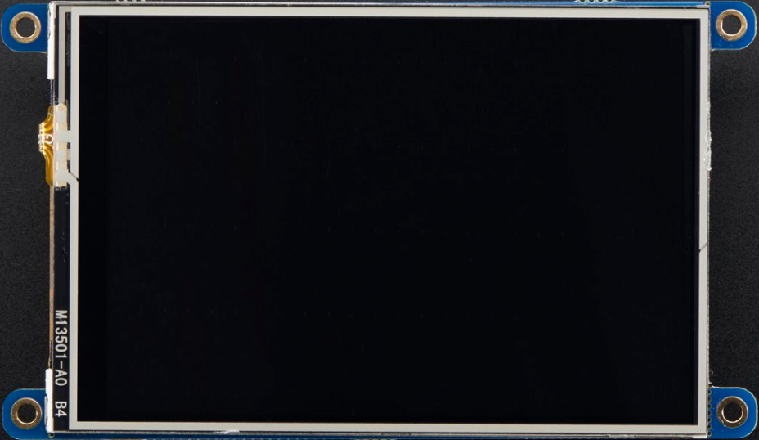
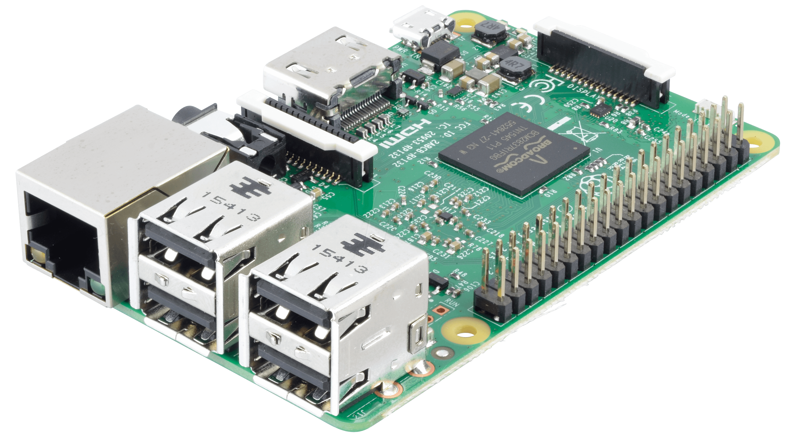
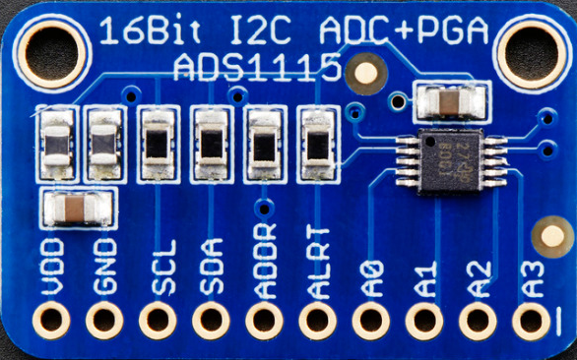
Hardware

Slide 5
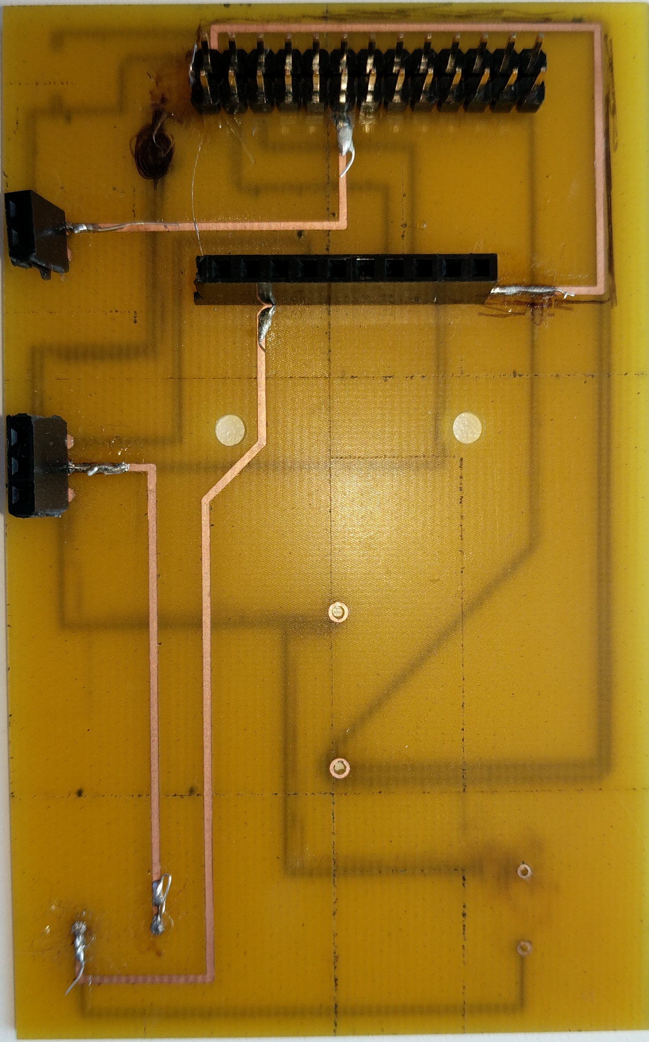
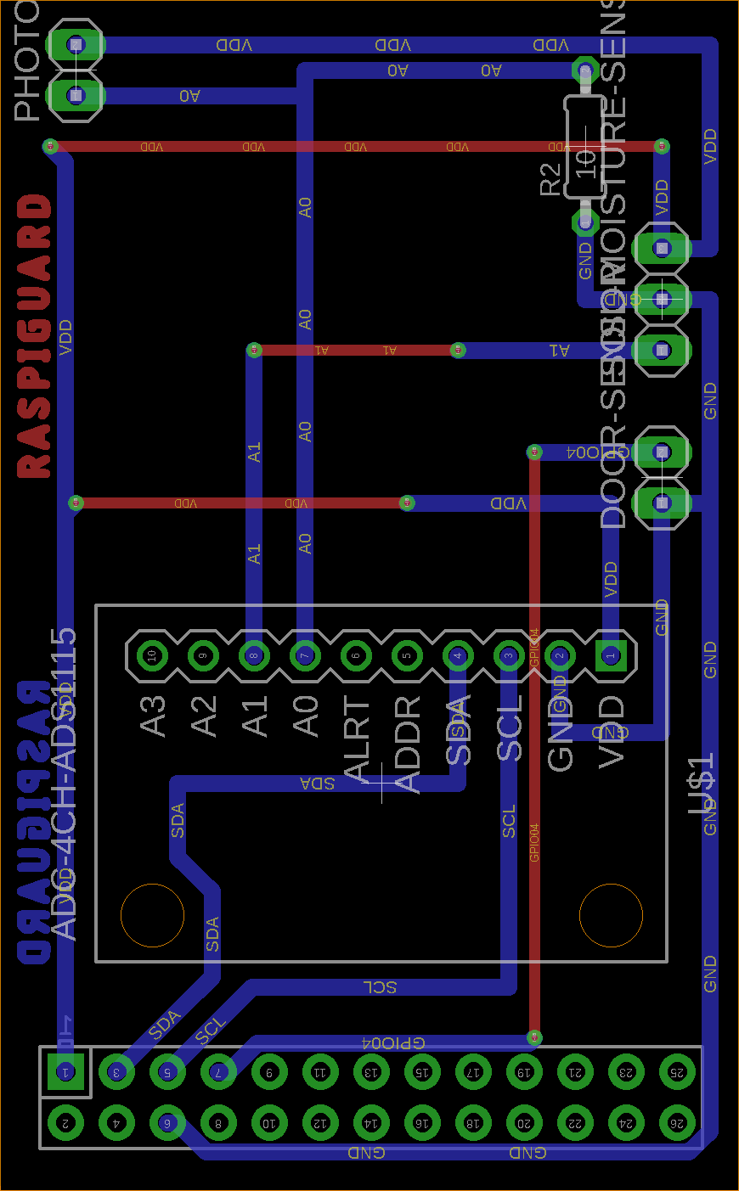
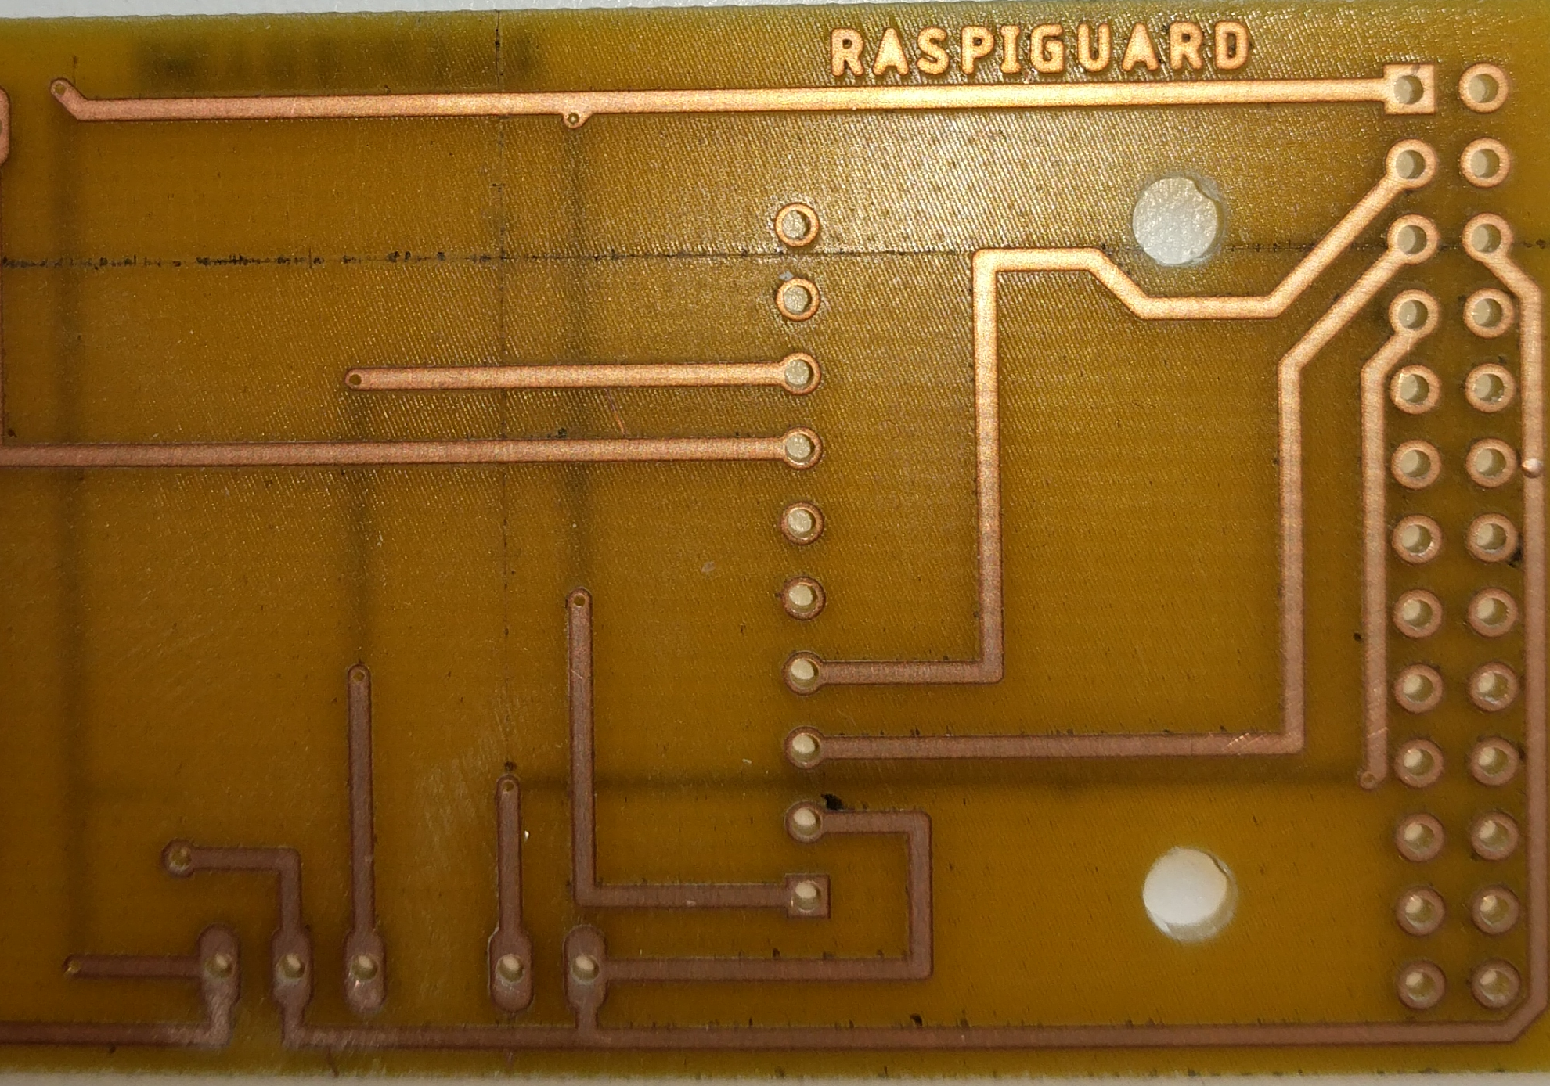
PCB

Slide 6



Software

Slide 7
Time For A Demonstration

Slide 8

Skills & Knowledge
Hardware:
Circuit building
Soldering
PCB Design
Software:
Java, Python, SQL
Web design, Android Programming
Linux (Raspbian)

Slide 9
Recommendations
Expand / Shrink RaspiGuard by changing Raspberry Pi and PiTFT model
Route PCB on one side to avoid connection errors and make soldering easier
Use DigitalOcean for VM services therefore full backend control

